Slide 1
DISEASES OF THE EXTRA PYRAMIDAL SYSTEM

Slide 2
DISEASES OF THE EXTRA PYRAMIDAL SYSTEM
1. PARKINSONS DISEASE
Is a clinical syndrome comprising of impairment of voluntary movement in which the main features are rigidity of the limbs, tremors and bradykinesia.

Slide 3
Aetiology
The disease develops after 50 years
The cause is unknown
It is associated with deficiency of dopamine
Secondary causes
1. Post encephalitic parkinsonism – Follow viral infections, can therefore occur before the age of 50.
2. Drugs
Prolonged use of Phenothiazides (chlorpromazine) - in mental patients- these drugs block post synaptic cells
Riserpine – in hypertensives depletes Dopamine from its stores.

Slide 4
3. Injury – repeated head trauma
4. Poisoning;
Carbonmonoxide poisoning
Manganese poisoning
Copper deposition in Wilson’s disease.

Slide 5
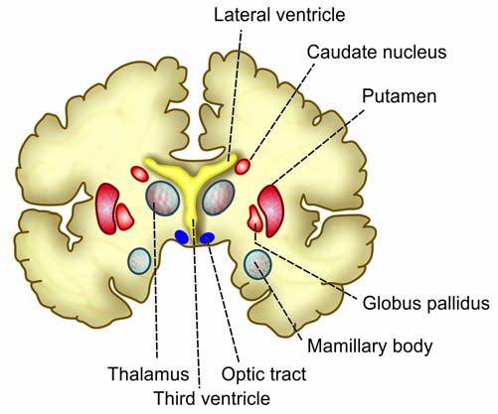
Basal Ganglia
1. Corpus striatum
2. Substantia nigra
3. Subthalamic nucleus of Luys.

Slide 6
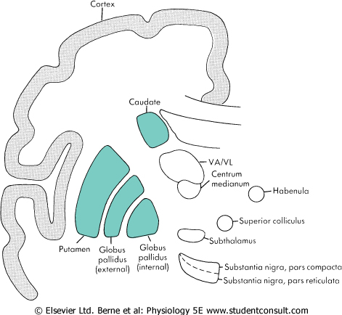

Slide 7
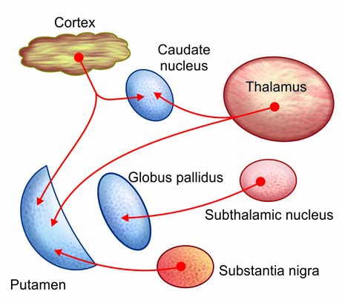
Afferent connections of corpus striatum

Slide 8
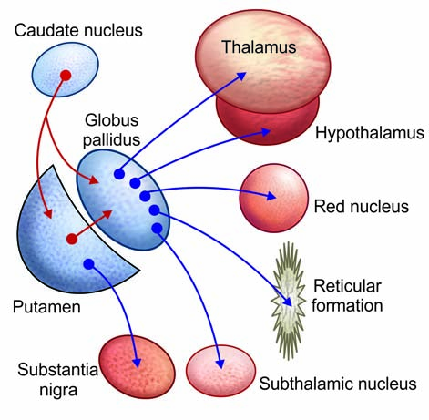
Efferent fibres

Slide 9
Pathology
-Damage to the interconnecting fibres between the substantia nigra and corpus striatum (use dopamine as the main neurotransmitter).
-There is loss of cells and depigmentation of the substantia nigra.
-There is atrophy of the globus pallidus and patchy cortical atrophy.

Slide 10
Clinical S+S
1. Tremor
First symptom
Usually course and regular, occurs about 6 times in a second.
Occurs first from one upper limb, then appears in the other, and later involves the tongue, and closed eyelids.
Present at rest but disappears in an attempt to use the hand.

Slide 11
2. Rigidity of limbs and face (cog wheel rigidity)
Face becomes expressionless most of the time.
3. Bradykinesia
4. A few patients develop oculogyric crisis – Eyes turn involuntarily upwards and stay there for minutes or hours. ( TX – Diazepam)
5. Drooling of saliva – Excessive salivation
Behaviour and sleep may be disturbed.

Slide 12
Diagnosis
Clinical S+S
The slowness of everything is very characteristic.
DDX
Physiological tremors – anxiety, Thyrotoxicosis
Alcoholism – Tremor is finer and faster
No accompanying rigidity
H/O hallucination and delusions
Senile tremor – affects the very elderly, No rigidity
Depression and hypothyroidism
Artherosclerosing dementia

Slide 13
Treatment
Remove the cause – stop or reduce drugs causing the symptoms
Anticholinergic drugs.
Benzhexol (Artane) – 2 – 5 mgs tds, increase dose every 3 days max 20mgs daily.
Levodopa 125 – 500mg bd after meals.

Slide 14
Other drugs.
Bromocriptine 2.5mgs bd – increase dose to 30 – 40mgs daily
Amantadine hydrochloride
Amphetamine
Trycyclic antidepressants
C/I drugs – MAOI
Prognosis
Levodopa ameliorates the disease but does not change the progression of the disease.

Slide 15
Tx B12 deficiency
Vitamin B12 deficiency is treated with hydroxycobalamin 1000 μg i.m. in five doses 2 or 3 days apart, followed by maintenance therapy of 1000 μg every 3 months for life.

